Slide 1
Git & GitHub
Presented by Aswini

Slide 2

Global Information Tracker

Slide 3

Chats
Status
Calls

Slide 4
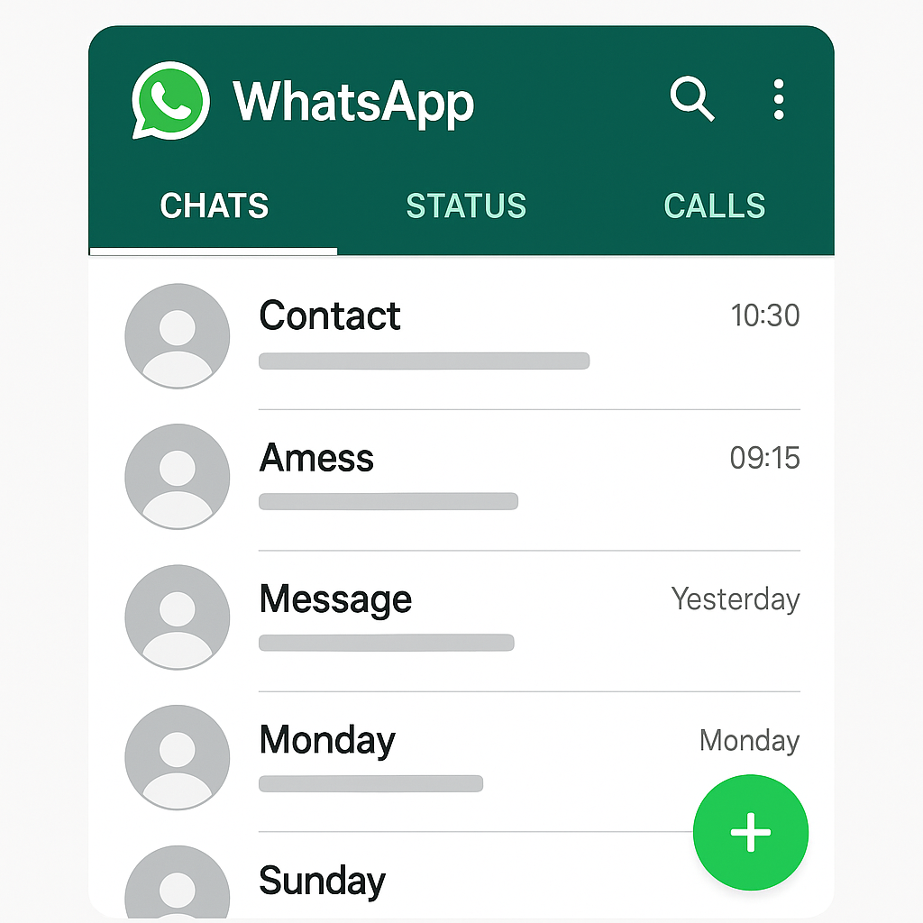
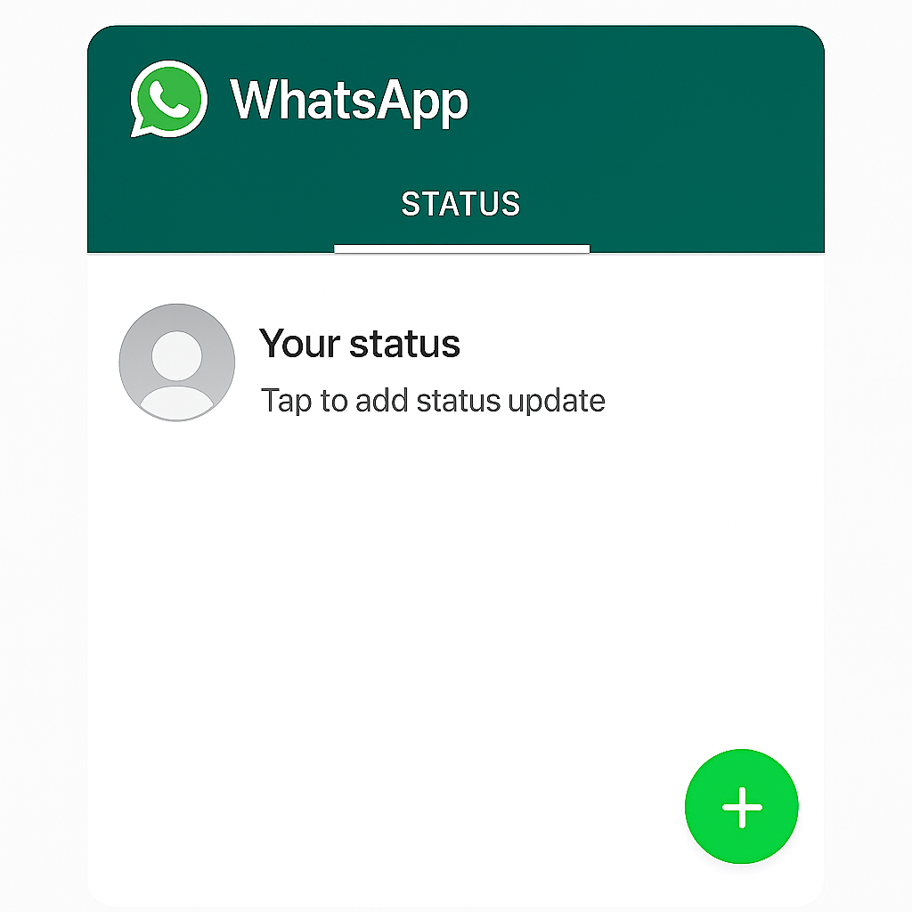
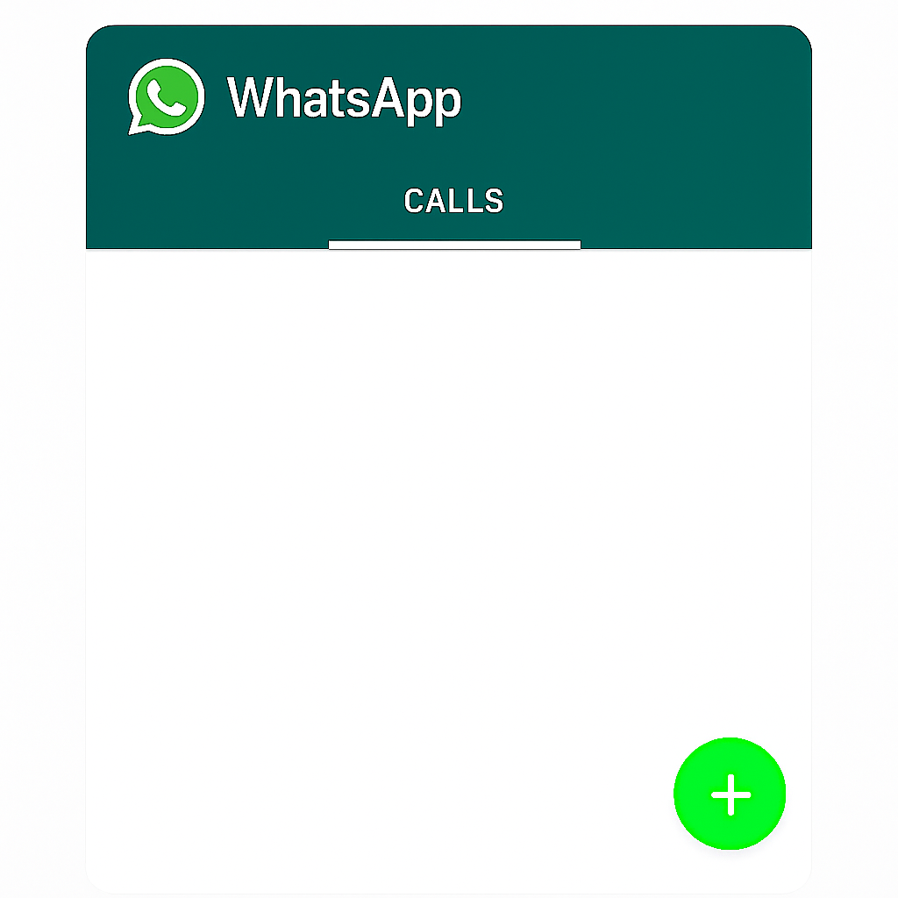
Dev 1
Dev 2
Dev 3

Slide 5
Git- Dev laptop
Github-Internet
Dev 1
Chats
Status
Git
Hub
Dev 2
Calls
Dev 3
Manager

Slide 6
What is Git?
Global Information Tracker
It is used to track the files.
Git is a distributed version control system used to track changes in source code.
It handles larger project effectively
It comes in the year 2005.
It is a 3rd generation VCS.

Slide 7
VCS
VCS means version control system.
It is used to store each version of code separately.
Example :
Version 1 → stores one folder
Version 2 →stores second folder.
Version 3 → stores third folder

Slide 8
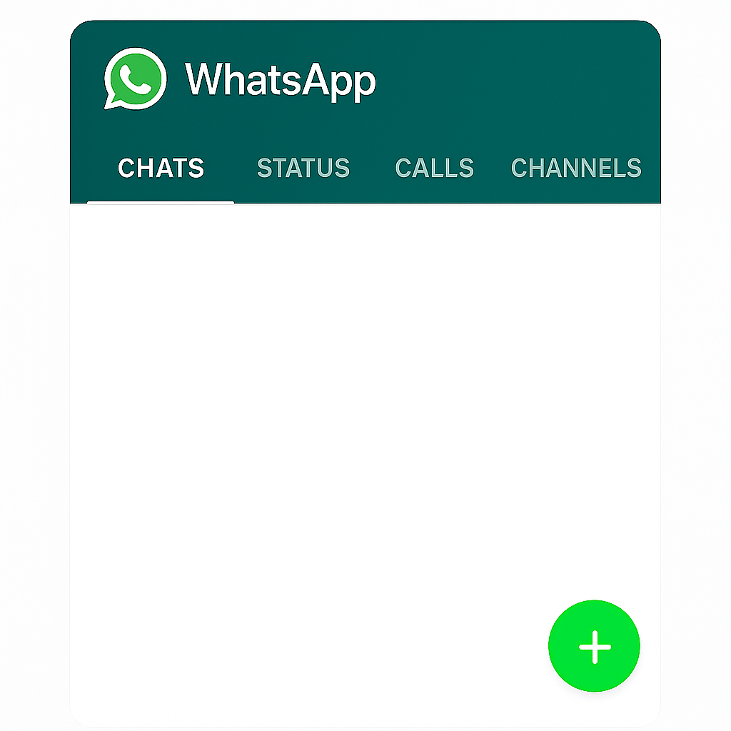
Version 1
Version 2

Slide 9
Git Workflow
Typical Git workflow involves multiple stages.
• Working Directory → Staging Area → Local Repo → Remote Repo (GitHub)

Slide 10
Common Git Commands
These commands help manage your code effectively.
git init – Initialize/create a repository
git add . – Stage changes/track the file
git commit -m "message" – Commit changes
git push – Upload to GitHub
git pull – Get latest changes
git log – to show the history

Slide 11
Branch
It an individual line of development for the code.
in real time multiple developers will be working on code.
each developer will write their code on their own branches.
Initially they create their branches on local laptop.
at the end, all developers will push the branch from local to github.
Default branch in git is MASTER.
NOTE: without a commit we cant see any branch in git

Slide 12
Branch commands
git branch : to show list of branches
git branch branch_name : to create a new branch
git checkout branch_name : to switch to a branch
git checkout -b branch_name : to create and switch to a branch at a time
git branch -m old_name new_name : to rename a branch
git branch -D branch_name : to delete a branch

Slide 13
What is GitHub?
GitHub is a cloud-based platform for hosting Git repositories.
• Allows team collaboration
• Supports pull requests, issues, and CI/CD
• Popular among developers for open-source projects

Slide 14
create a github account and create a repo
git remote add origin https://github.com/aswini7501/paytm.git
How to generate a token profile -- > settings -- > developer settings -- > Personal access token -- > classic -- > generate new token -- > classic -- > name: whatsapp -- > select 6 scopes -- > generate

Slide 15
GitHub Collaboration Features
GitHub supports team collaboration through:
• Forking repositories
• Cloning and making changes
• Creating pull requests
• Tracking issues

Slide 16
Getting Started for Students
Steps to start using Git & GitHub:
• Create a GitHub account
• Install Git on your computer
• Explore GitHub Classroom or GitHub Codespaces

Slide 17
Thank you

